Slide 1
PEP Input Class
Presented By
Kanika Sharma

Slide 2
Recursion
The process in which a function calls itself directly or indirectly is called recursion and the corresponding function is called a recursive function.

Slide 3
How recursive function store in memory?
Recursion uses more memory, because the recursive function add to the stack with each recursive call, and keep the values there until the until the call is finished.
Recursive function uses LIFO (LAST FILL FIRST OUT) Structure just like stack data

Slide 4
Understanding recursion
What is base condition in recursion?
How a particular problem is solved using recursion?
Why Stack Overflow error occurs in recursion?

Slide 5
Types of recursion
Direct Recursion: These can be further categorized into four types:
Tail Recursion: If a recursive function calling itself and that recursive call is the last statement in the function then it’s known as Tail Recursion. After that call the recursive function performs nothing.
// Code Showing Tail Recursion
#include <iostream>
using namespace std;
// Recursion function
void fun(int n)
{
if (n > 0) {
cout << n << " ";
fun(n - 1);}}
int main()
{
int x = 3;
fun(x);
return 0;
}

Slide 6
Types of recursion
#include <bits/stdc++.h>
using namespace std;
// Recursive function
void fun(int n)
{
if (n > 0) {
fun(n - 1);
cout << " "<< n;
}
}
int main()
{
int x = 3;
fun(x);
return 0;
}
Head Recursion: If a recursive function calling itself and that recursive call is the first statement in the function then it’s known as Head Recursion. There’s no statement, no operation before the call.

Slide 7
Types of recursion
fun(n)
{
// some code
if(n>0)
{
fun(n-1);
fun (n-1);
}
// some code
}
Tree Recursion: Otherwise if a recursive function calling itself for more than one time then it’s known as Tree Recursion.

Slide 8
Types of recursion
Indirect Recursion: In this recursion, there may be more than one functions and they are calling one another in a circular manner.

Slide 9
Example
Let us consider a problem that a programmer has to determine the sum of first n natural numbers, there are several ways of doing that but the simplest approach is simply to add the numbers starting from 1 to n. So the function simply looks like this,
approach(1) – Simply adding one by one
f(n) = 1 + 2 + 3 +……..+ n

Slide 10
Example
approach(2) – Recursive adding
f(n) = 1 n=1
f(n) = n + f(n-1) n>1

Slide 11
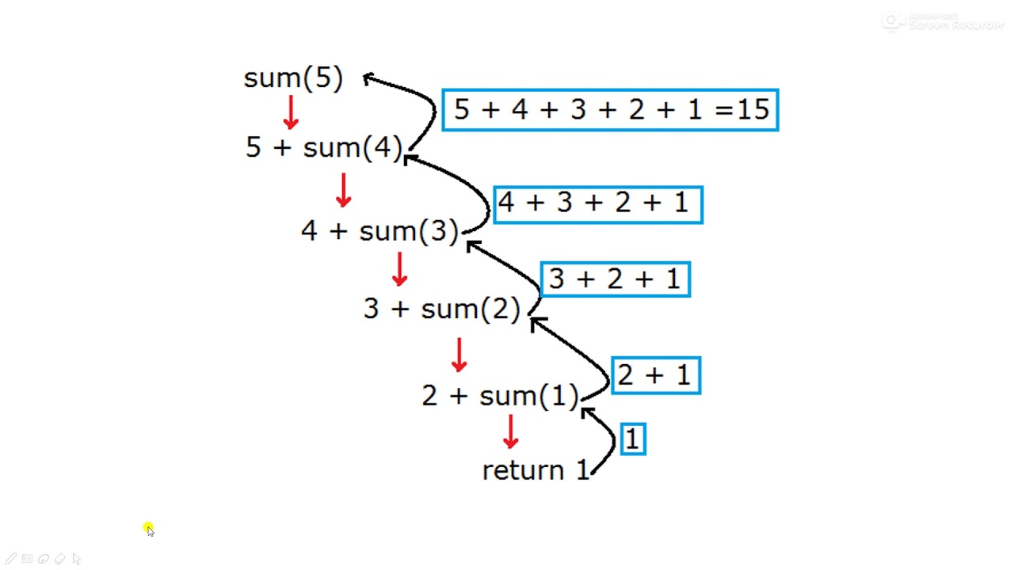
Sum of n numbers

Slide 12
Code: sum of n natural numbers
#include <iostream>
using namespace std;
int addDigit(int num) {
if (num <= 0) {
return 0;
}
return num +addDigit (num-1);
}
int main() {
int n, result;
cout << "Enter a number \n";
cin >> n;
result = addDigit(n);
cout << "Sum of n number is " << result;
return 0;
}

Slide 13
Complete the code: sum of digits using recursion
int main() {
int n, result;
cout << "Enter a number \n";
cin >> n;
result = addDigit(n);
cout << "Sum of digits of a number is " << result;
return 0;
}
#include <iostream>
using namespace std;
int addDigit(int num) {
//Complete the code
}

Slide 14
Sum of digits using recursion
int main() {
int n, result;
cout << "Enter a number \n";
cin >> n;
result = addDigit(n);
cout << "Sum of digits of a number is " << result;
return 0;
}
#include <iostream>
using namespace std;
int addDigit(int num) {
if (num <= 0) {
return 0;
}
return ( num % 10) + addDigit( num / 10);
}

Slide 15
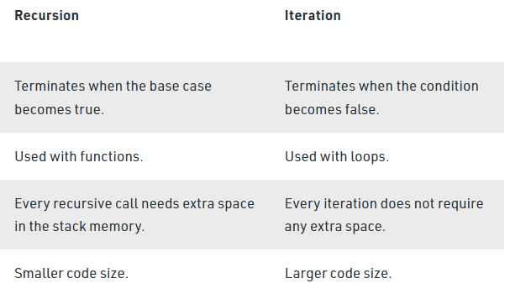
Recursion vs. iteration

Slide 16
Predict the output
#include <iostream>
using namespace std;
void fun(int x)
{
if(x > 0)
{
fun(--x);
cout << x <<" ";
fun(--x);
}
}
int main()
{
int a = 4;
fun(a);
return 0;
}

Slide 17
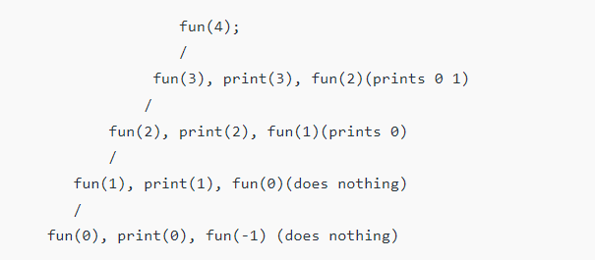
Output:
0 1 2 0 3 0 1

Slide 18
Predict the output
#include <iostream>
using namespace std;
int fun(int a[],int n)
{
int x;
if(n == 1)
return a[0];
else
x = fun(a, n - 1);
if(x > a[n - 1])
return x;
else
return a[n - 1];
}
int main()
{
int arr[] = {12, 10, 30, 50, 100};
cout << " " << fun(arr, 5) <<" ";
getchar();
return 0;
}

Slide 19
Output
100

Slide 20
Thanks.

